Slide 1
4 BITS PASSWORD SECURITY

Slide 2


Submitted By:
2022456 Muhammad Younas
2022420 Saad Ullah Khan Haidari
Supervised By
Sir Irfan Ullah
Lecturer
Ghulam Ishaq Khan Institute of Information Technology University, Topi

Slide 3

OBJECTIVES
To design and implement a 4-bit password security system using NOR and XOR gates. This system aims to provide a user-friendly and cost-effective solution for securing access to doors, bank lockers, digital appliances, and switching systems. The project focuses on creating a reliable and practical security mechanism, enhancing the overall safety of various applications

Slide 4

COMPONENT LIST
4001 quad NOR gate
4070 quad XOR gate
Two four-position DIP switches
Two light-emitting diodes (LED)
Four 4007 "switching" diodes
Ten 10k ohms resistors
Two 470 ohms resistors
Pushbutton switch (normally open)
9-volt battery

Slide 5
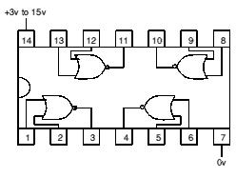
4001 Quad NOR Gate
The 4001 Quad NOR Gate is a fundamental digital logic IC that plays a key role in processing logical NOR operations within electronic circuits. In the context of our 4-bit password security system project, the 4001 Quad NOR Gate is responsible for executing logical NOR functions, crucial for comparing and validating the entered data with the stored key code. NOR gates output a high signal (1) only when none of their inputs are high (0), making them essential for creating a secure password validation system. The 4001 Quad NOR Gate serves as a building block for constructing the logical framework that determines access authorization within our security system

Slide 6

4070 Quad XOR Gate
The 4070 Quad XOR Gate is a vital component in digital circuitry, specifically designed for performing exclusive OR (XOR) operations. In our 4-bit password security system project, the 4070 XOR Gate plays a critical role in comparing the entered data with the key code. XOR gates produce a high output (1) only when the number of high inputs is odd, making them essential for password validation. The 4070 Quad XOR Gate is instrumental in creating a secure and reliable mechanism for verifying the correctness of the entered code.

Slide 7
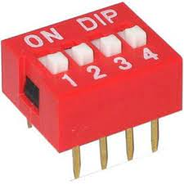
Four-Position DIP Switches
Four-Position Dual Inline Package (DIP) switches are integral to our 4-bit password security system, serving as both "KEY CODE SWITCHES" and "DATA ENTRY SWITCHES." These switches provide a convenient means for users to input and store the password. The position of each switch determines the binary code entered into the system. The Four-Position DIP Switches play a fundamental role in configuring and securing access to the system, making them a key component in our project.

Slide 8
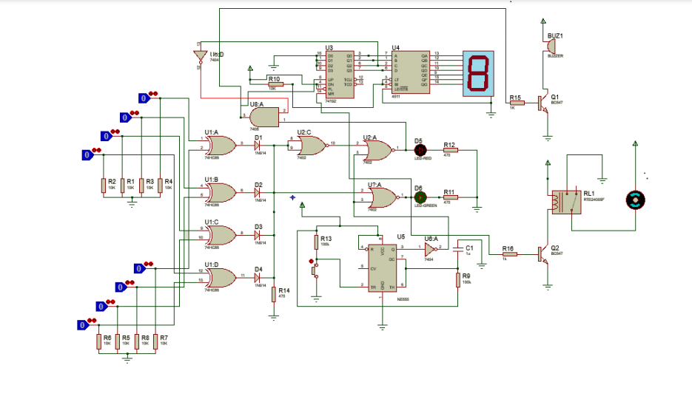

Slide 9

CONSTRUCTIONS
Install the IC’s and resistors neatly on the bread board.
Wire the pins 7 & 14 of both IC’s to Vcc& GND respectively.
Wire one end of the switches with Vcc.
Wire one end of resistors to GND.
Now connect the other end of the switches to the resistors and wire it to the gates of XOR IC.
Now the output of the XOR is sent as inputs in NOR IC and is grounded with help of a resistor simultaneously.
Connect the led lights (green & red) and ground them with help of resistors

Slide 10
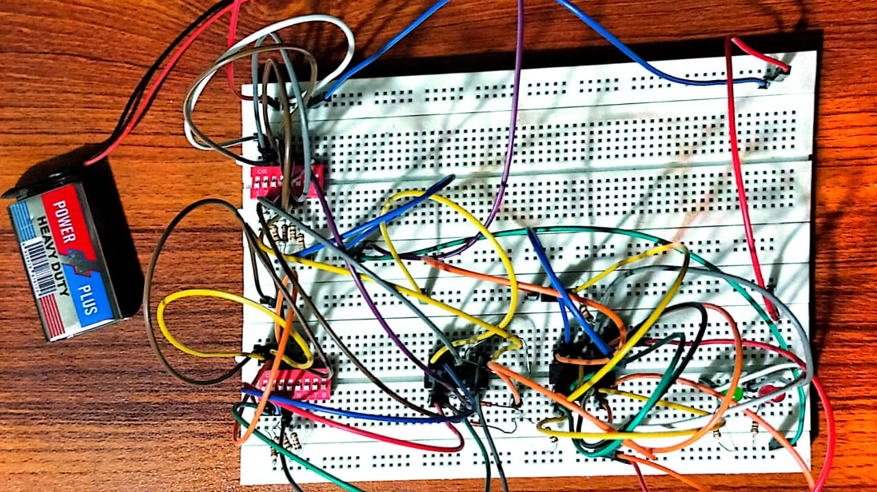

Slide 11

WORKING PRINCIPLE
The XOR gates compare the entered data with the key code, and the NOR gates generate output signals based on the comparison results. The green LED indicates a correct password match, while the red LED signals an incorrect attempt.

Slide 12
CONCLUSION
The 4-bit password security system offers a practical and effective solution for enhancing security in various applications. It's simple design and reliable operation make it suitable for both residential and commercial settings.

Slide 13
THE END

